Slide 1
Accessibility Features and Practices in Canvas
Emily L Duncan
elduncan@mst.edu

Slide 2
Text Formatting
Font: serif, sans serif
Style: bold, italics, underline
Color: text color and highlight
Alignment: left, right, center, justified
Case: uppercase, lowercase, sentence case
Structure: lists, headings, and indentation

Slide 3
Style
Bold, italics, underline
Use bold and italics sparingly
Large walls of bold or italic text can be difficult to read
Underline should be reserved for hyperlinks, not text emphasis

Slide 4
Case
In general, use sentence case or title case
Avoid all caps when not using an acronym
All caps can be difficult to read
Screen readers don’t always communicate all caps

Slide 5
Color
Text with color can be used in page design
Color contrast ratio minimum 4.5:1 for small text
No need for additional styling
If color is used as emphasis,
Use color in conjunction with other text formatting, i.e., bold or italics
Color contrast rules still apply
Remember, avoid all caps and underline as emphasis
Color palette generator and contrast checker

Slide 6
Headings Overview
Provide page structure/outline content
Improve readability
For all users
Visual (can be altered)
Font size, style, color, alignment
Hidden (in the coding)

Slide 7
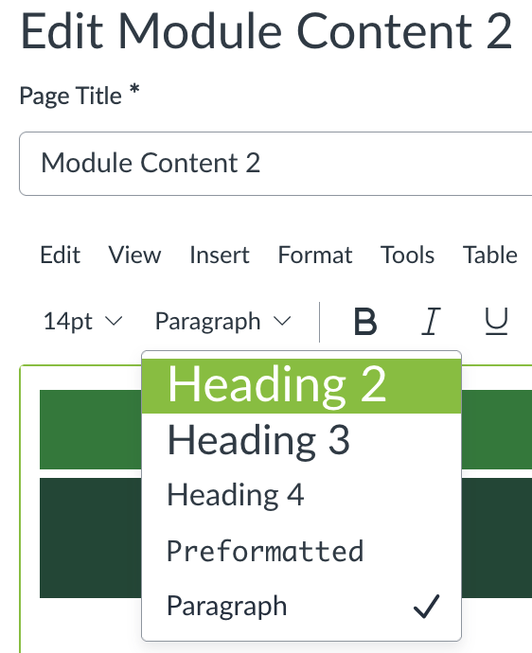
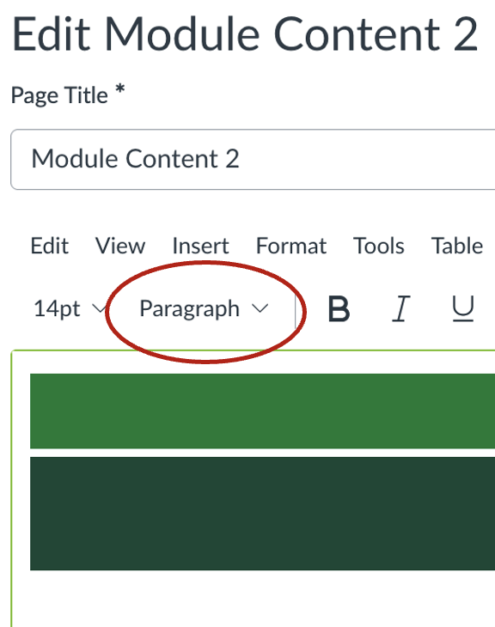
Heading Hierarchy
In Canvas, H1 is the page title
Heading levels 2–4 can be selected
Nest headings in order
Do not skip heading levels

Slide 8
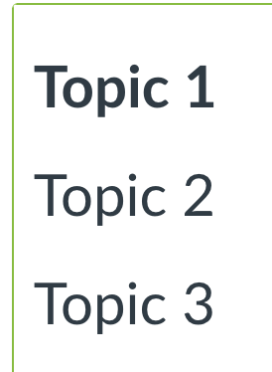
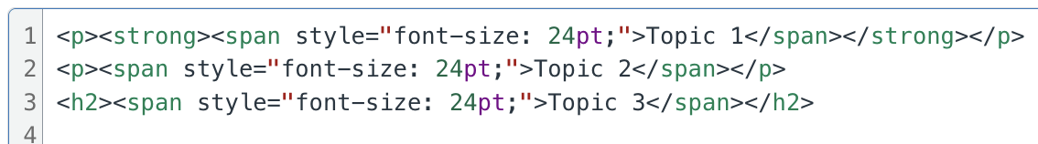
Which is a Heading?

Slide 9
Heading Styles
Visual styling does not make headings accessible
Larger font, bold, underline, alignment, etc. do not change the text to a heading in the html

Slide 10
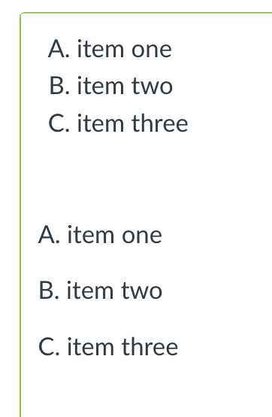
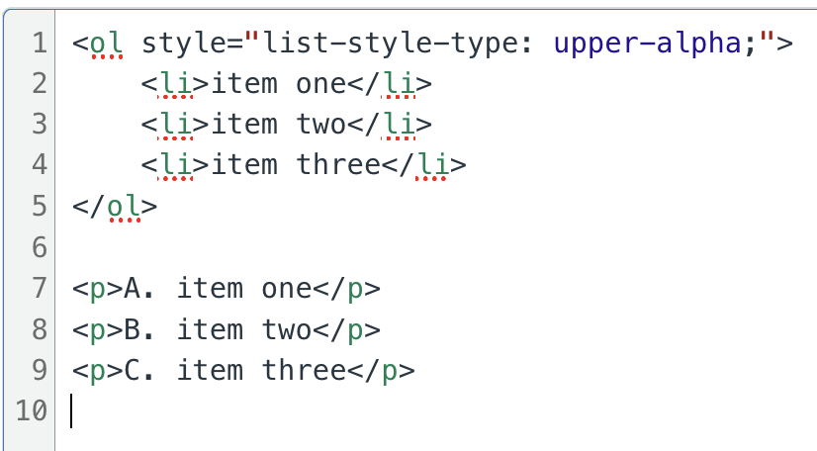
Lists

Slide 11
Tables
Tables should: | Tables should not:
Be used to organize data | Be used to style content
Have table headings and captions | Have merged or split cells

Slide 12
Resources
Harvard University. (2025). Design for readability. In Digital Accessibility.
Instructure. (2025). Canvas course accessibility checklist.
Nuffer, S. (n.d.). Create amazing pages in Canvas. In Tutorials. How to Canvas.
Stanford University IT. (September 11, 2023). Typography. In Office of Digital Accessibility.
The Accessibility Guy. (May 29, 2024). Document uses style elements like headings in a hierarchical manner [Video]. YouTube.
University of Minnesota. (2025). Accessibility for organization and text formatting emphasis. In College of Continuing & Professional Studies.
World Wide Web Consortium. (2025). Web Content Accessibility Guidelines (WCAG) 2.1.

